Slide 1
Signal

Slide 2
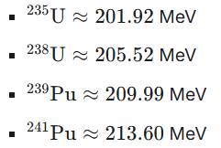
Neutrino Flux from Reactor
Reactor neutrino flux is produced via beta decay.
Reactor neutrino is purely anti-electron neutrino.
Above 2 MeV, Huber-Mueller model in 1106.0687, 1101.2663
Below 2 MeV, P. Vogel et.al calculated in Phys. Rev. C 24, 1543 (1981).
2304.14992 is a comprehensive revision of theory and ex data. We use its result from all ~10000 beta decay branches and rescale it by specific thermal power.
235U, 239Pu, 241Pu, 238U are major actinides in reactors.

Slide 3
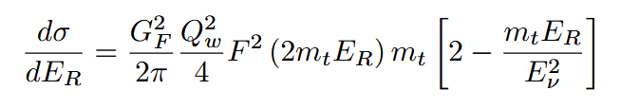
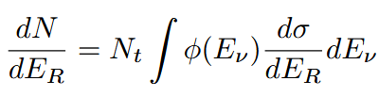
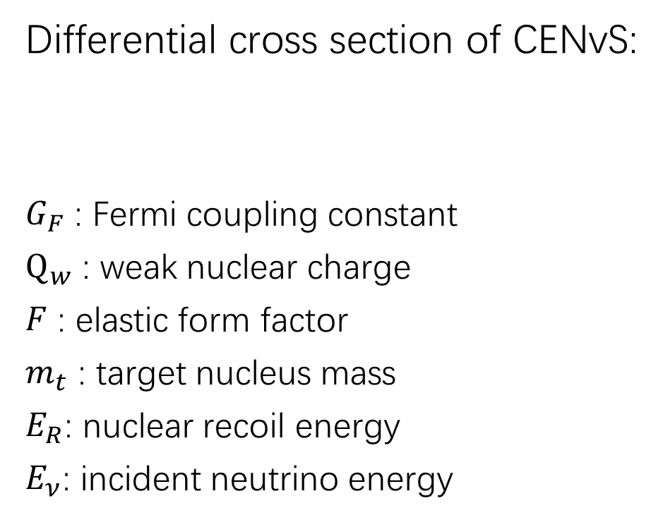
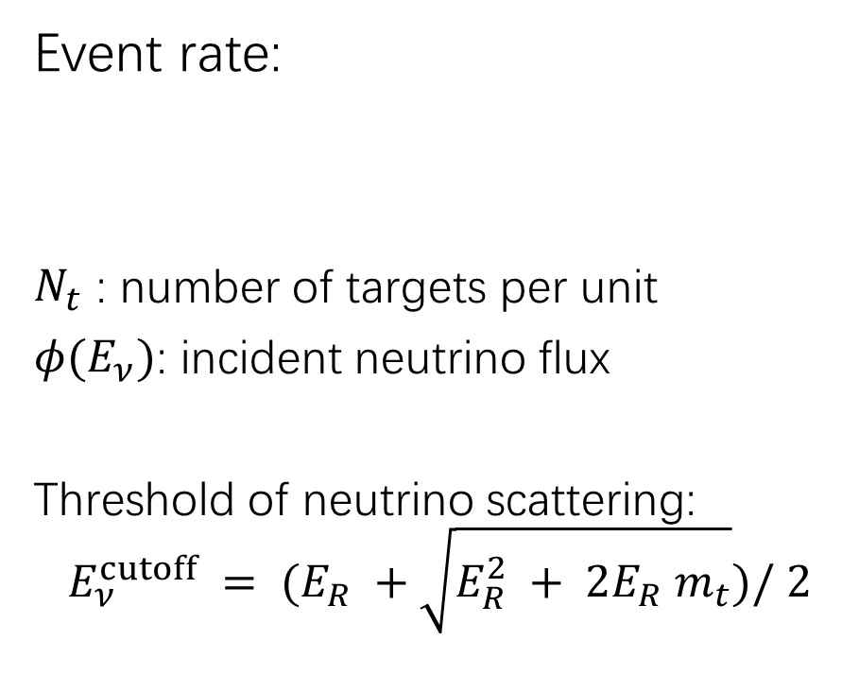
CENvS Event Rate
Differential cross section of CENvS:
$G_{F}$ : Fermi coupling constant
$Q_{w}$ : weak nuclear charge
$F$ : elastic form factor
$m_{t}$ : target nucleus mass
$E_{R}$: nuclear recoil energy
$E_{ν}$: incident neutrino energy
Event rate:
$N_{t}$ : number of targets per unit
$φ(E_{ν})$: incident neutrino flux
Threshold of neutrino scattering:
$$E_{ν}^{cutoff} = (E_{R} +\sqrt{E_{R}^{2} + 2E_{R} m_{t}})/ 2$$

Slide 4
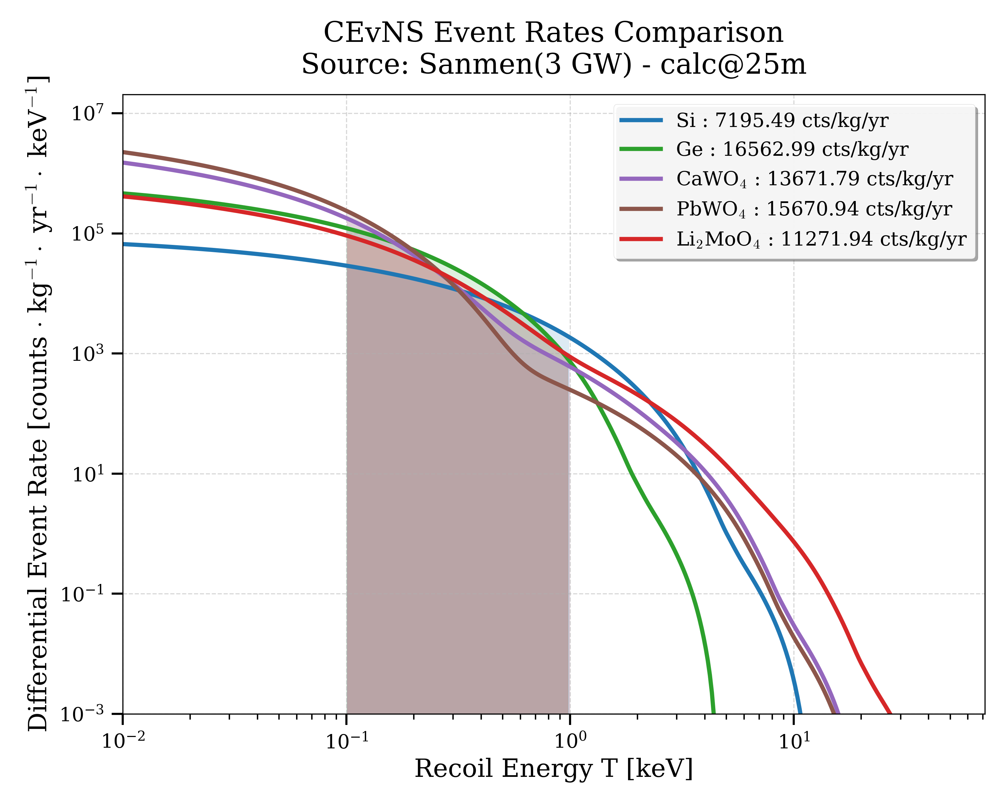
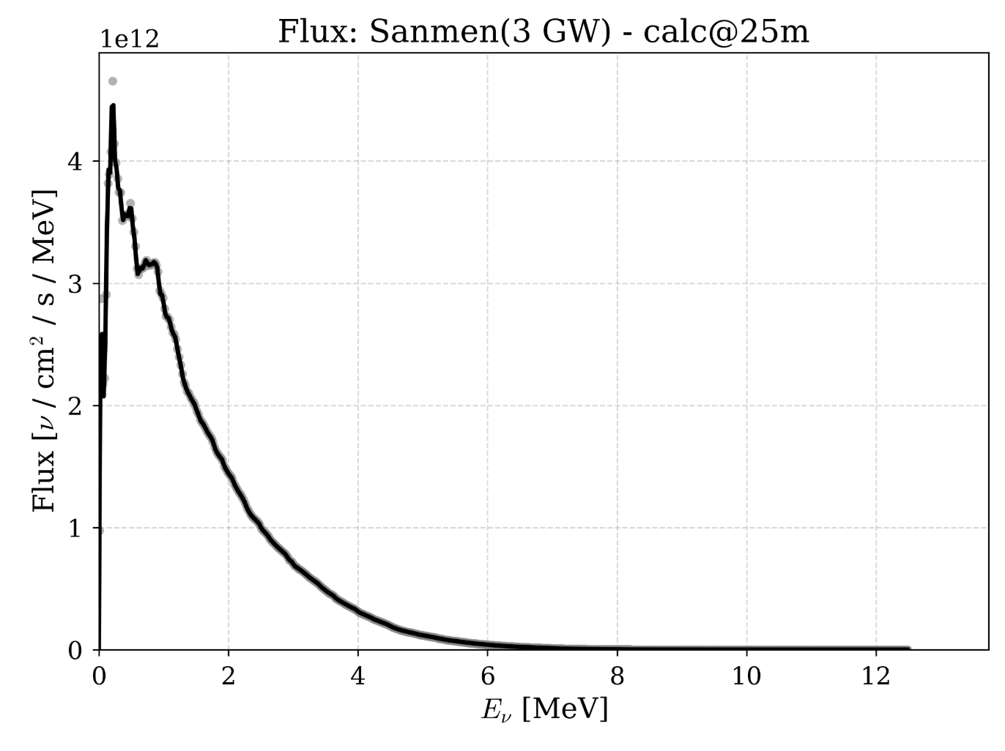
Signal Prediction: 100-1000eV

Slide 5
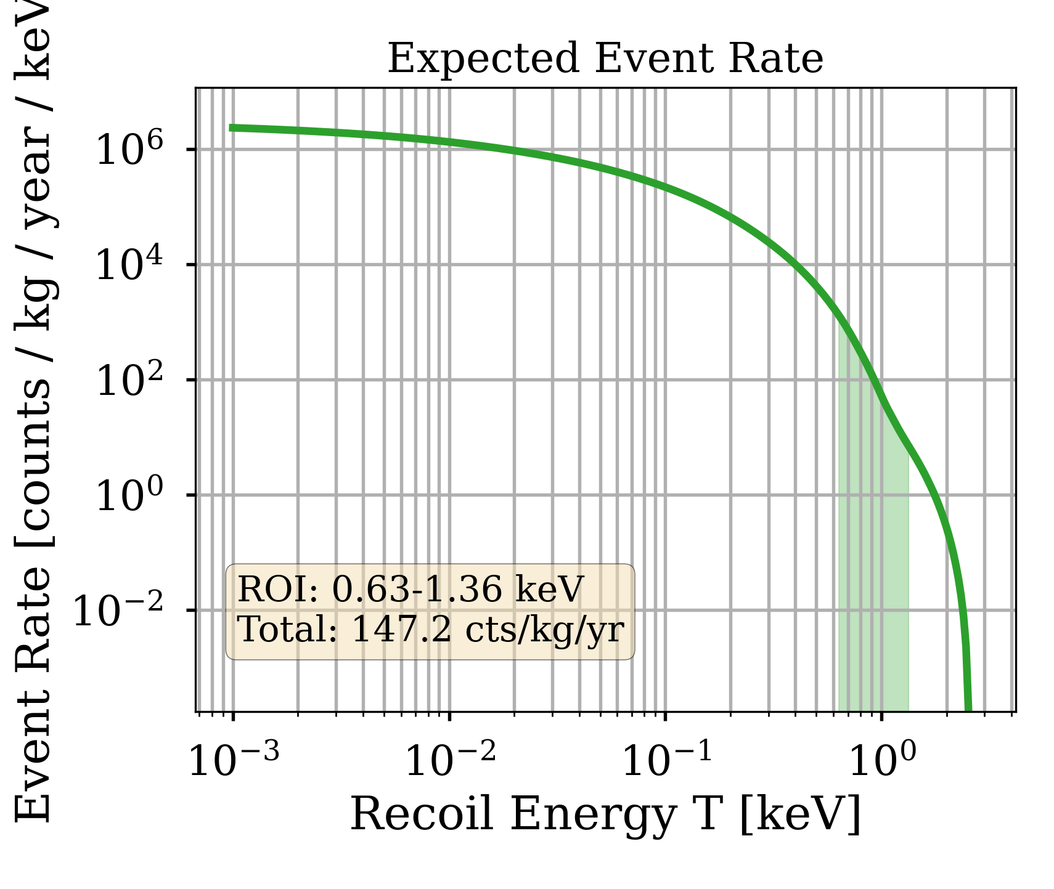
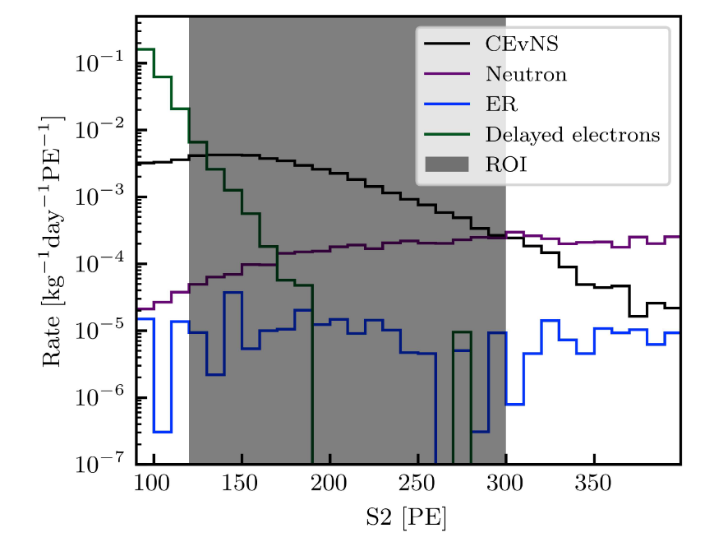
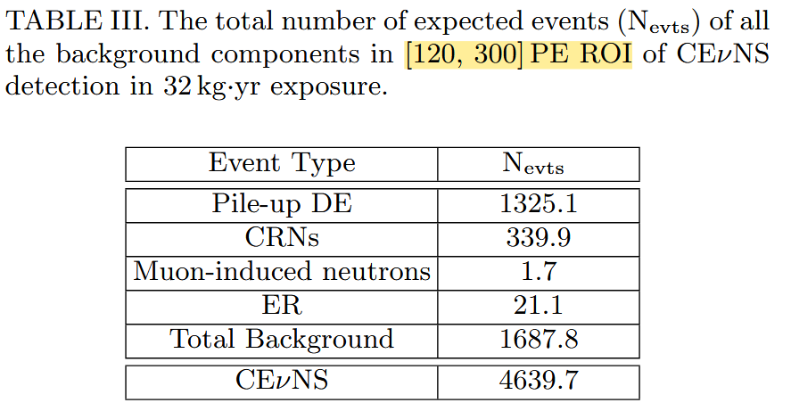
Compare with RELIC
Our detector have 75 times enhancement.
2405.05554
In their paper, threshold is increased from 0.3keV to 0.63keV in order to avoid the DE background.

Slide 6
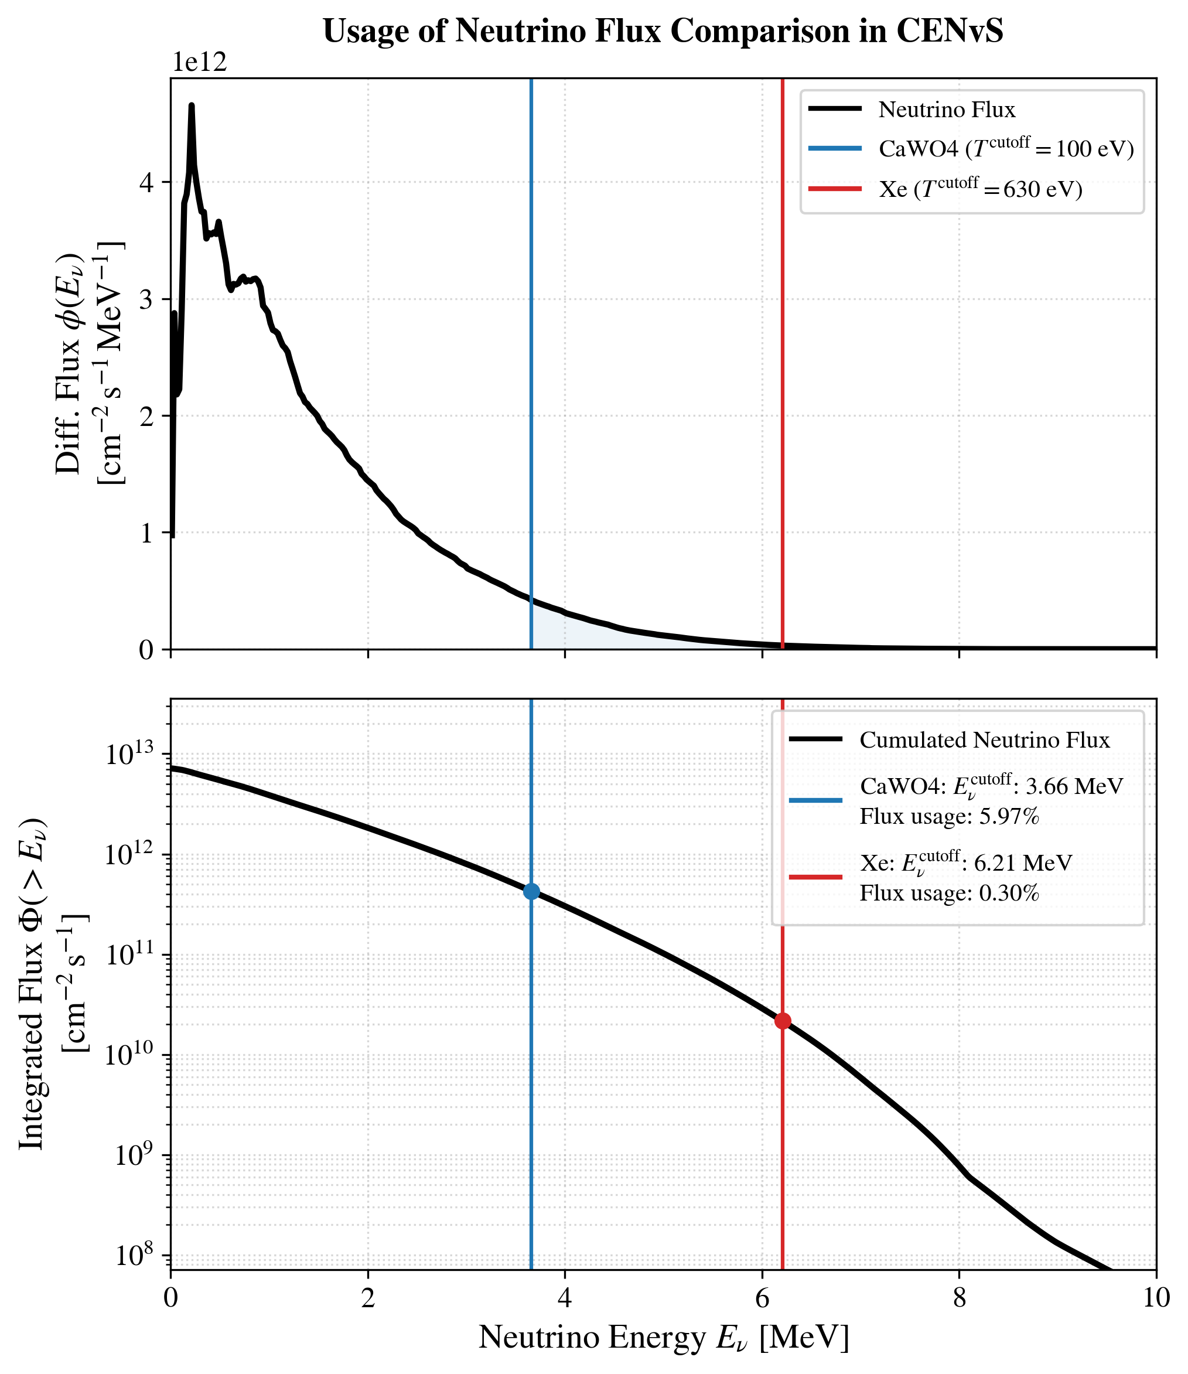
Enhanced Neutrino Usage
Most reactor neutrinos are produced at low energy.
A smaller ROI can significantly enhance the CENvS event rate.

Slide 7
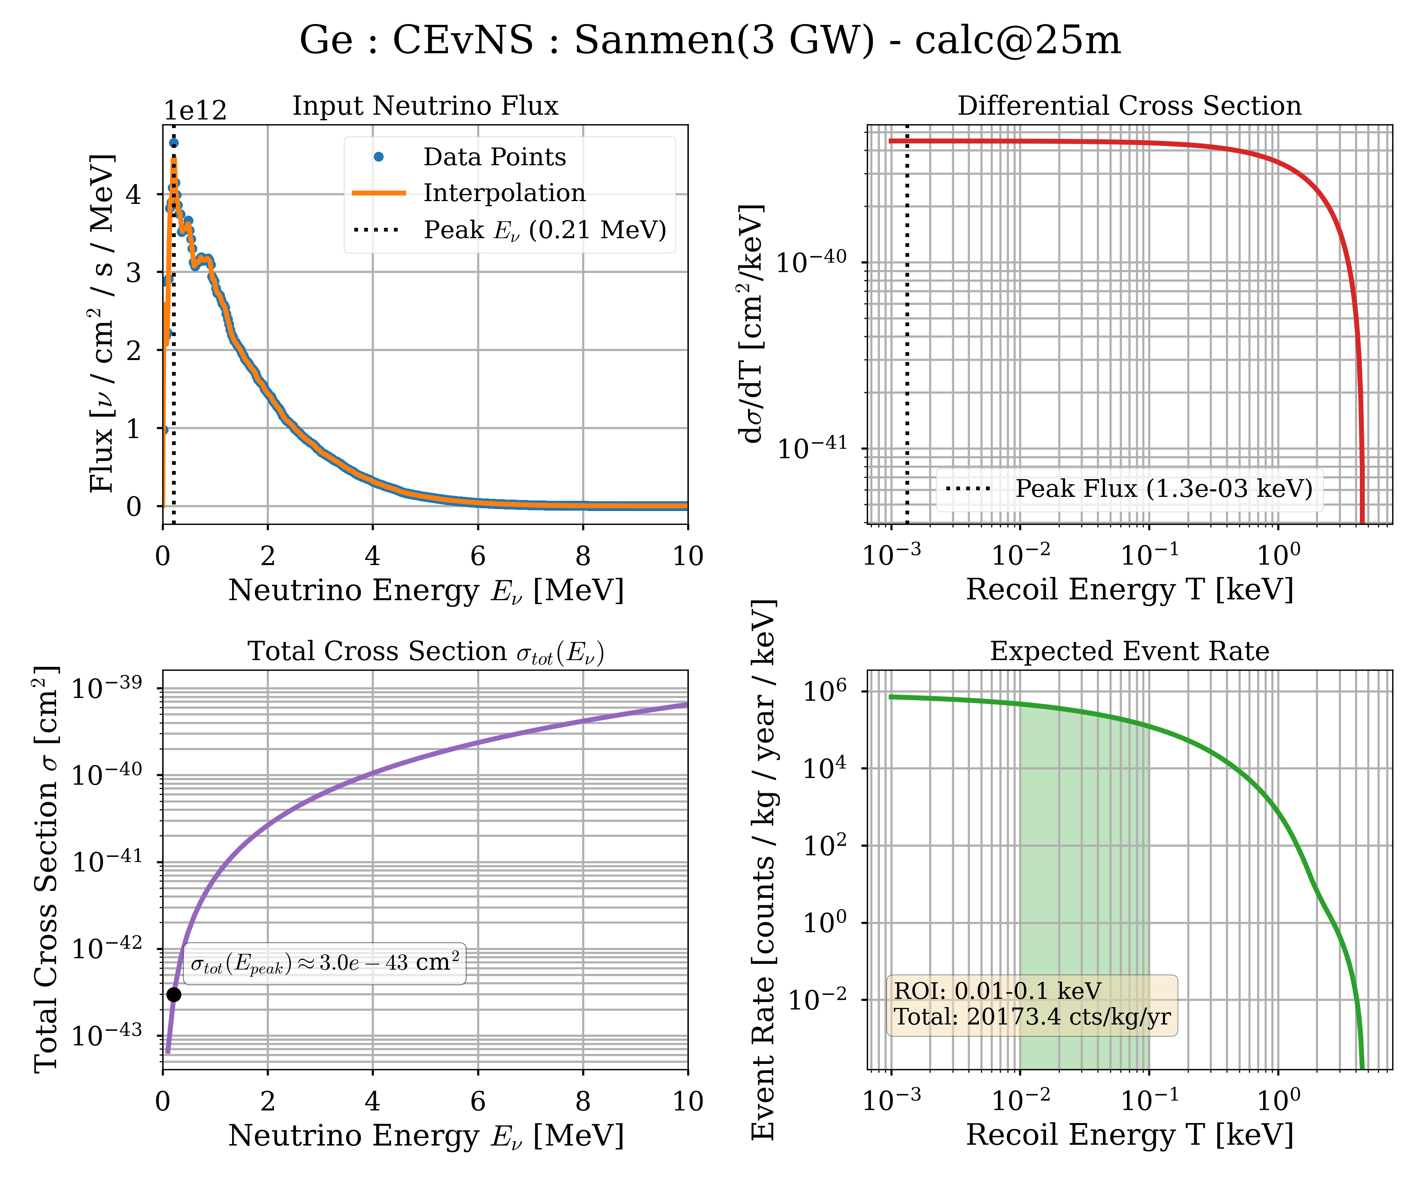
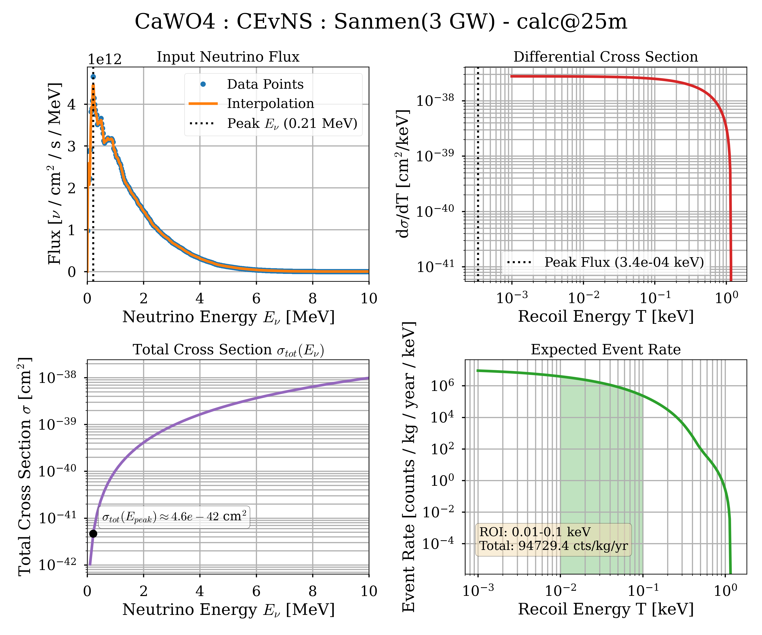
Backup :Other Signal Prediction 10-100eV

Slide 8
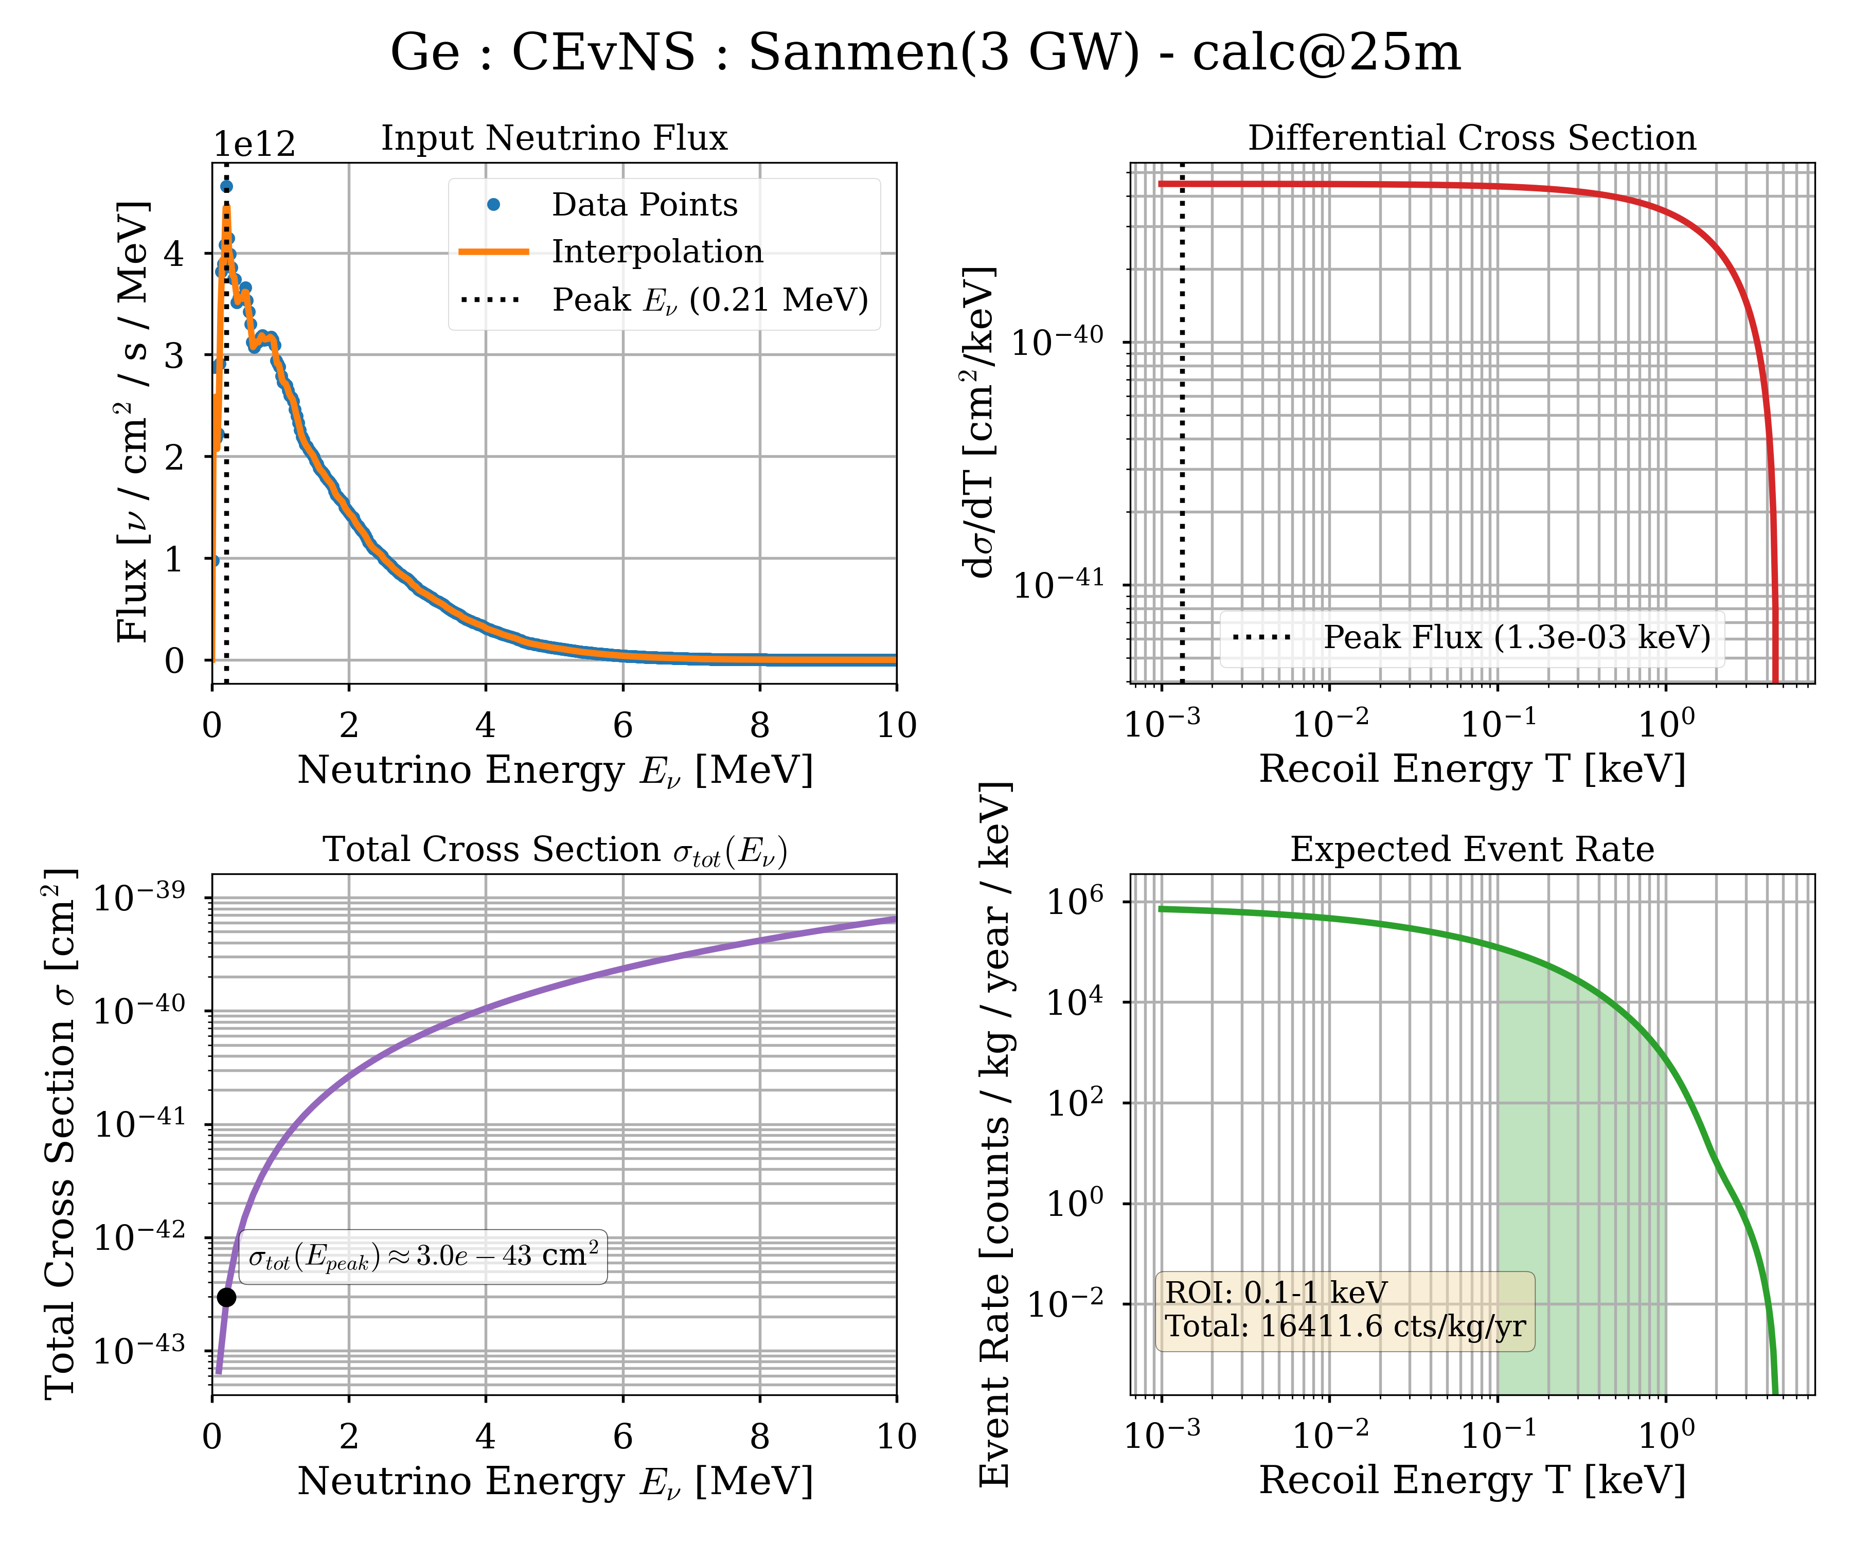
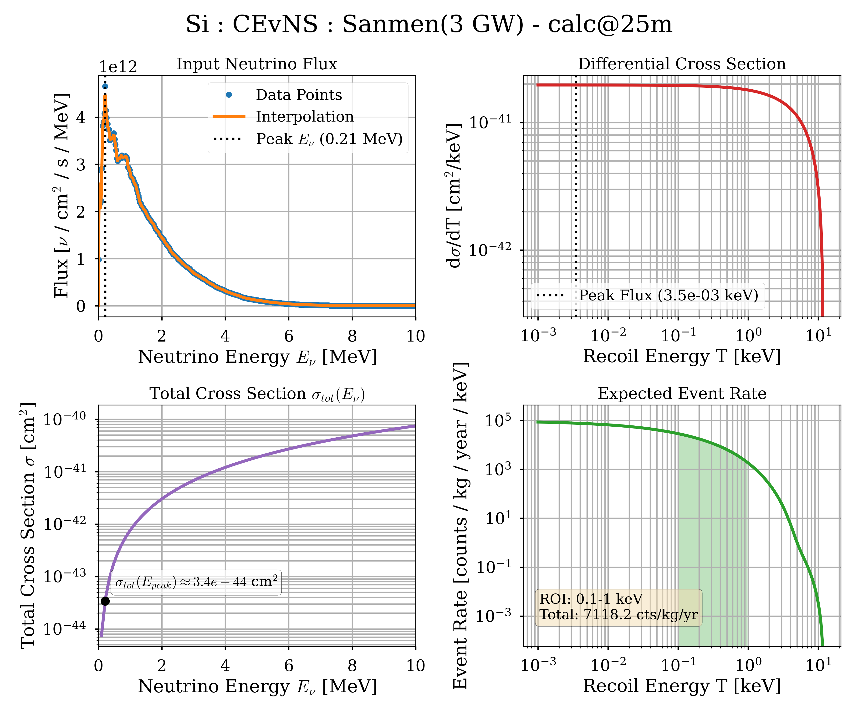
Backup :Other Signal Prediction 100-1000eV
104 times L-XE
48 times L-XE

Slide 9
Background & LEE

Slide 10
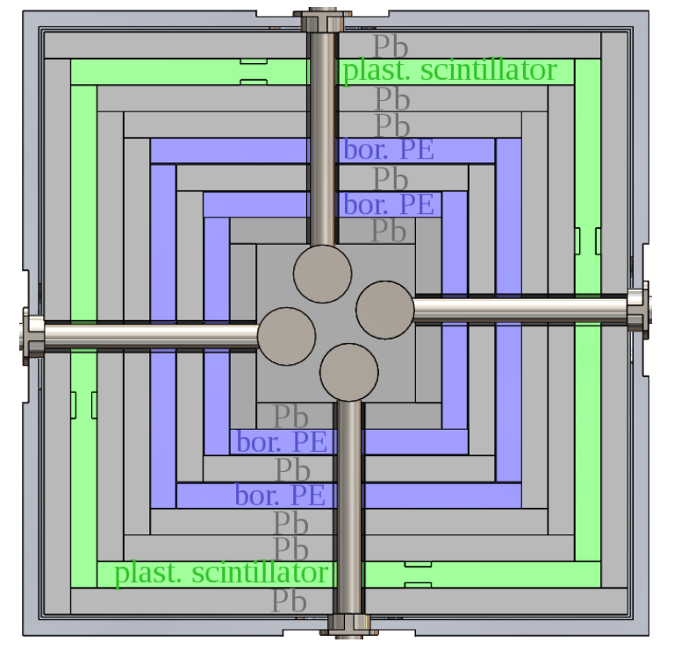
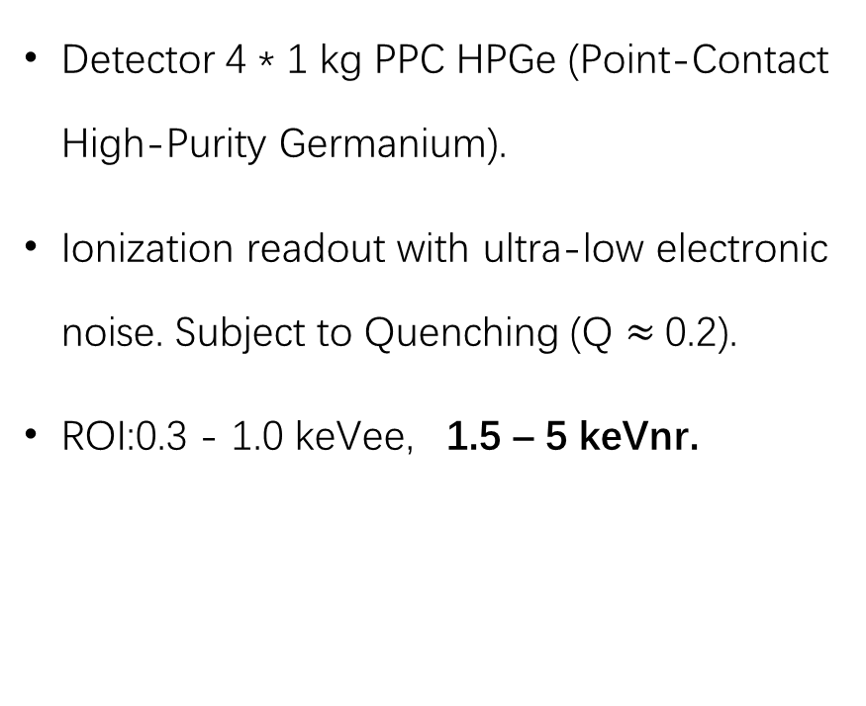
CONUS: Detector & Shielding
Detector 4 * 1 kg PPC HPGe (Point-Contact High-Purity Germanium).
Ionization readout with ultra-low electronic noise. Subject to Quenching (Q $≈$0.2).
ROI:0.3 - 1.0 keVee, 1.5 – 5 keVnr.
5cm per layer
10.1088/1742-6596/1342/1/012094

Slide 11
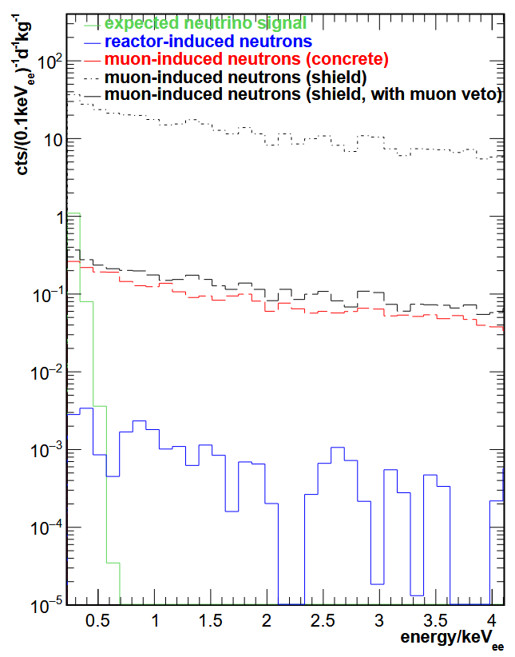
CONUS: MC Background after Shielding
Neutron NR signals are leading background.
Gamma ray ER signals are negligible.
Integral count from 0 to 450 keV is (11±2)·10−5 kg−1d−1.
Their ROI is too high and avoids LEE.
Background: 3000 counts / (keV kg year) (Flat plateau).

Slide 12
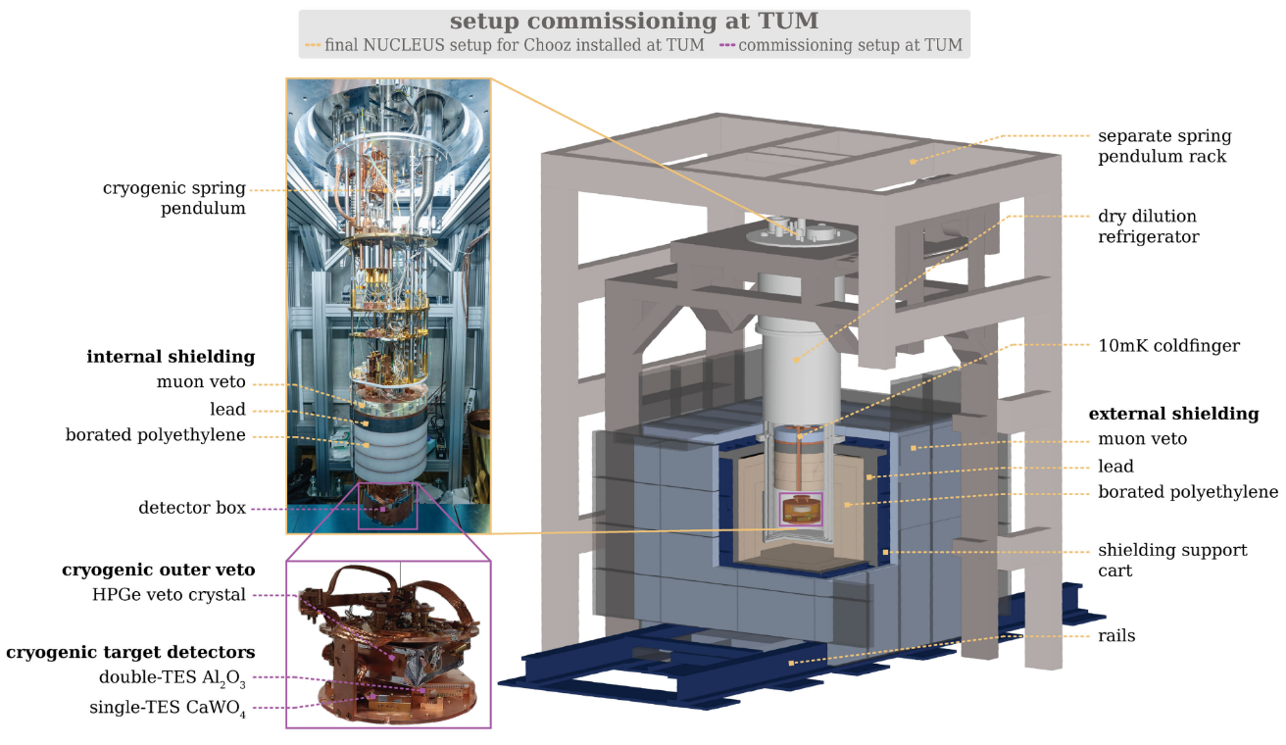
NUCLEUS: Detector & Shielding
Detector:
CaWO4, 9*0.76g, Single TES
5*5*5 mm3,
15mk transition T
Al2O3 9*0.75g, Double TES
5*5*7.5 mm3,
15.1mk transition T
ROI: 10-100eVnr
10.1103/c95p-8kh2

Slide 13
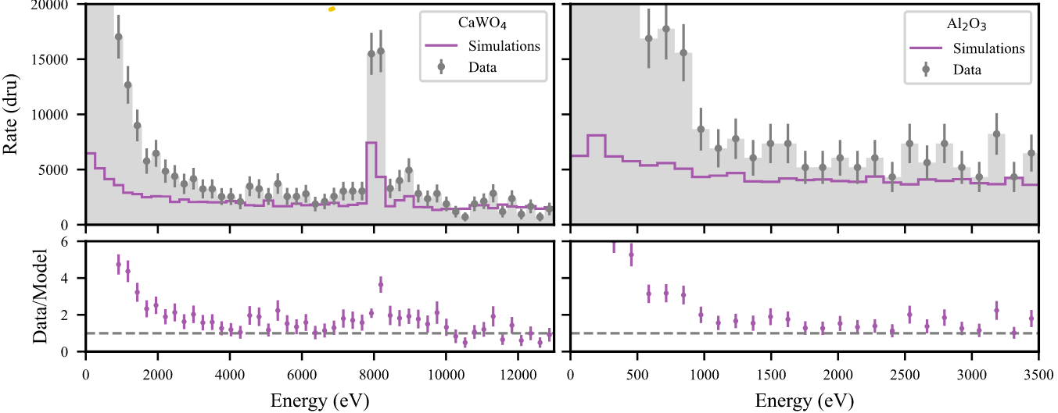
NUCLEUS: MC Background & Measured LEE
CaWO4: LEE is 30,000 times bigger than CENvS signal.

Slide 14
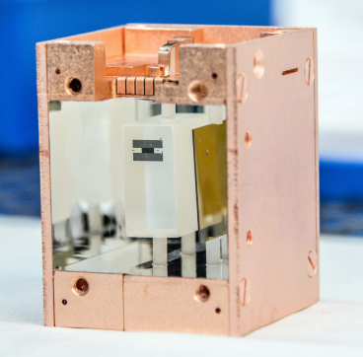
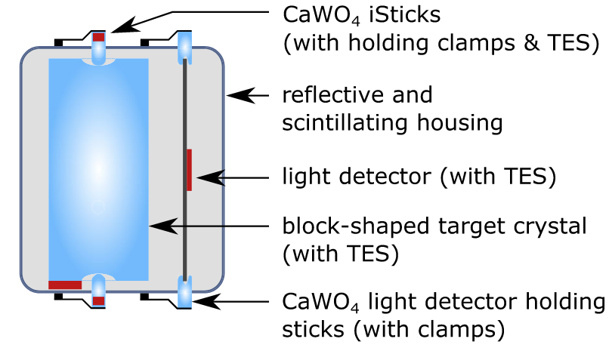
CRESST-III: Detector
10.1088/1742-6596/1342/1/012076
Detector: CaWO4,
20*20*10 mm3, 24g
Phonon Detector: W-TES
Light Detector: SOS & W-TES
Other targets are also tested.
ROI: 30.1 eV - 16.0 keV
10.1103/PhysRevD.100.102002

Slide 15
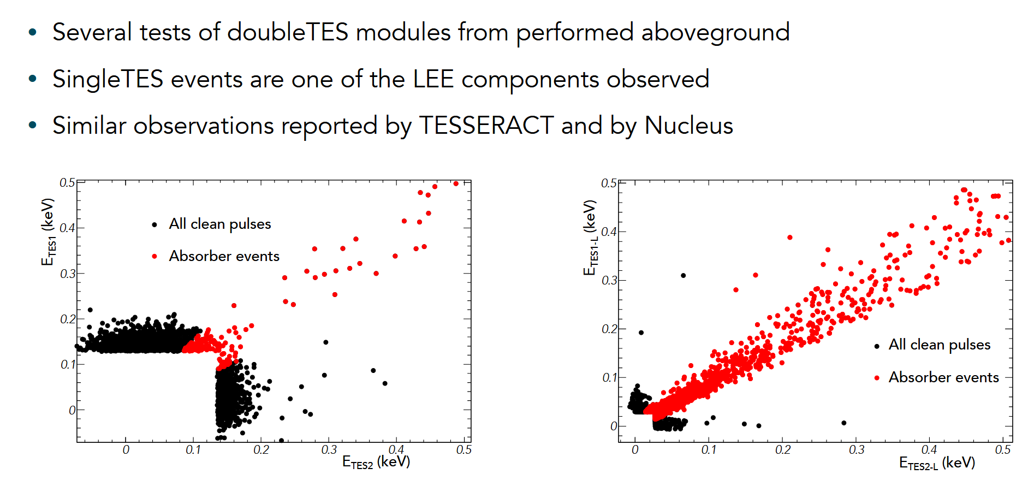
Backup: Event Selection of CRESST-III
CRESST-III @ EXCESS25

Slide 16
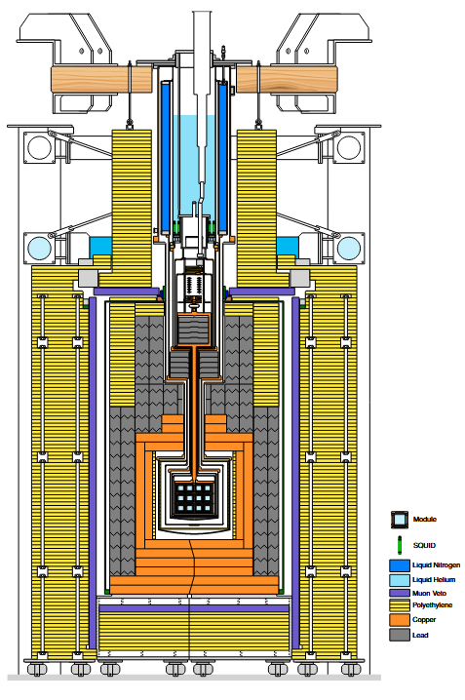
CRESST-III: Shielding
LNGS deep-earth laboratory (3600 m),
Outermost layer: PE 45 cm.
Lead layer: 20 cm.
HP Copper layer: 14 cm
Mun Veto
They consider particle background negligible.
CRESST-III @ EXCESS Workshop25

Slide 17
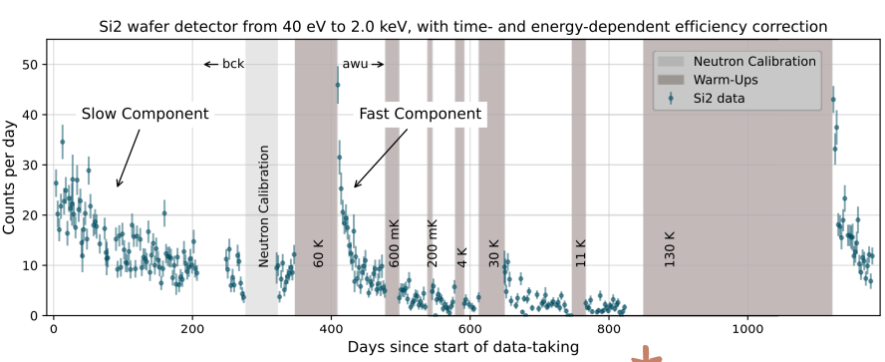
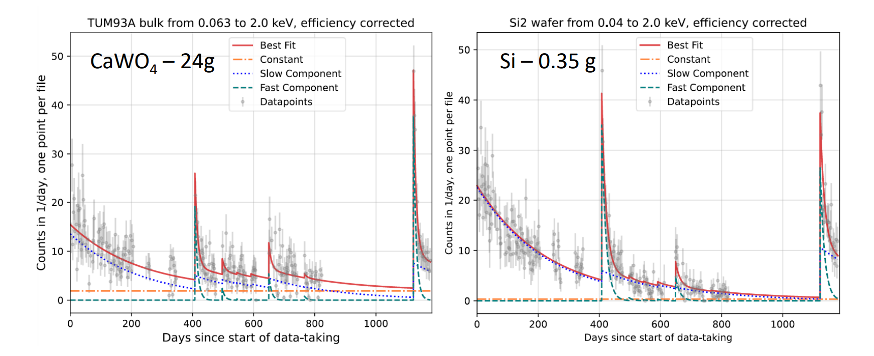
CRESST-III: LEE
CRESST-III @ EXCESS 25
CRESST-III @ EXCESS 24

Slide 18
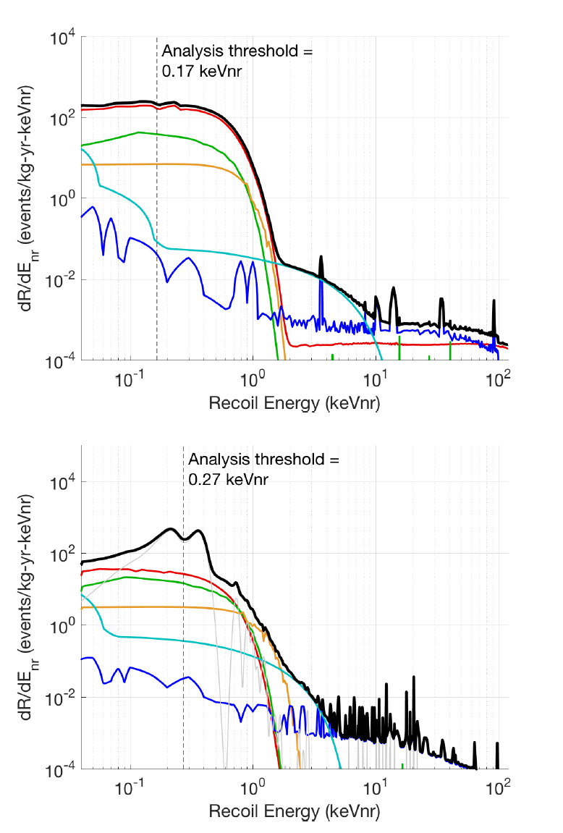
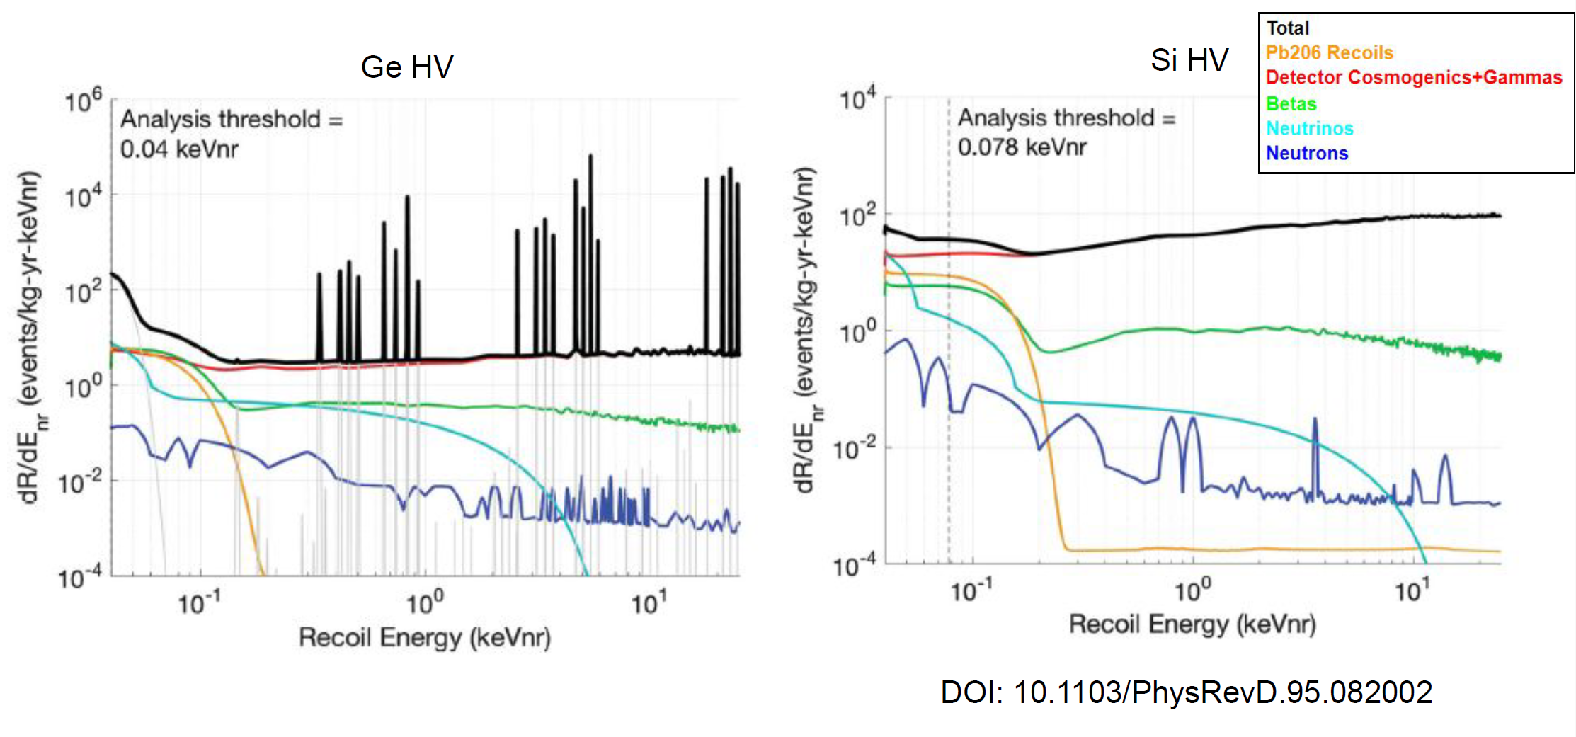
SuperCDMS SNOLAB: shielding & particle backgrounds
• SNOLAB depth (~6000 m.w.e.) suppresses muons and cosmogenic neutrons
• Shielding: polyethylene (n), Pb/Cu (γ), radon control, low‑activity materials
• Si and Ge targets used for complementarity and cross‑checks
• Dominant ER: internal β decays (³²Si in Si, ³H in Ge)
• Dominant NR: coherent neutrino–nucleus scattering
• These components set the sub‑keV particle‑background floor
iZip detector
<- HV detector

Slide 19
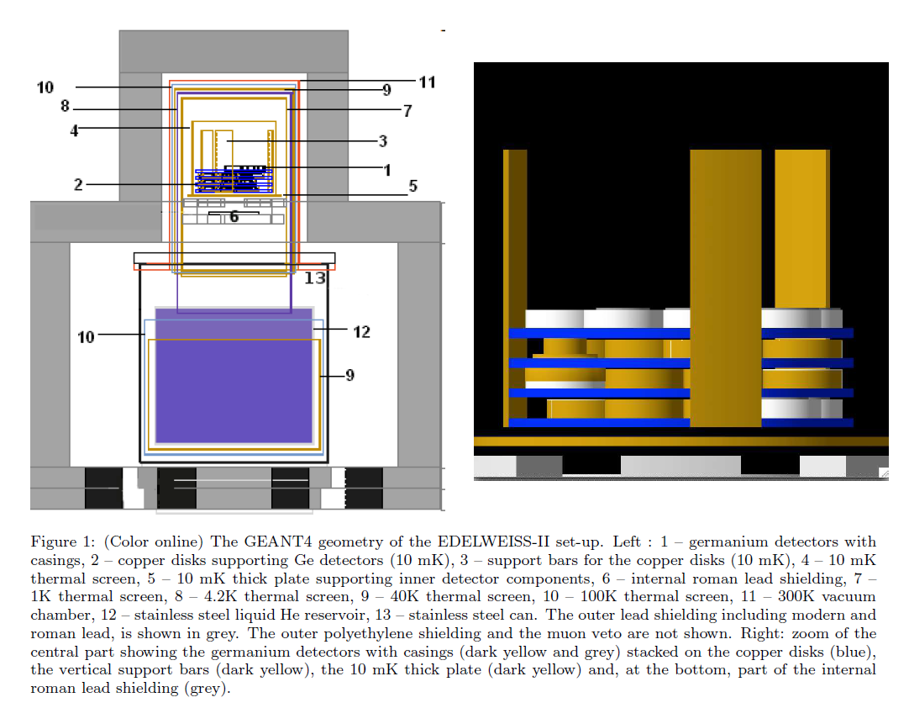
EDELWEISS: experiment design, shielding, and target choice
• Underground site: LSM, 4800 m.w.e. overburden reduces muon flux
• Cryogenic Ge bolometers: simultaneous heat + ionization readout enables strong γ rejection; interleaved electrodes reject surface events
• Shielding concept: Pb for γ, polyethylene for n, plus active muon veto. 18 cm modern Pb + 2 cm roman Pb + 50 cm polyethylene, surrounded by plastic scintillator muon veto
• Target justification (Ge): mature cryogenic technology, high radiopurity handling, and compatibility with high-bias / NTL concepts used in later sub-keV programs

Slide 20
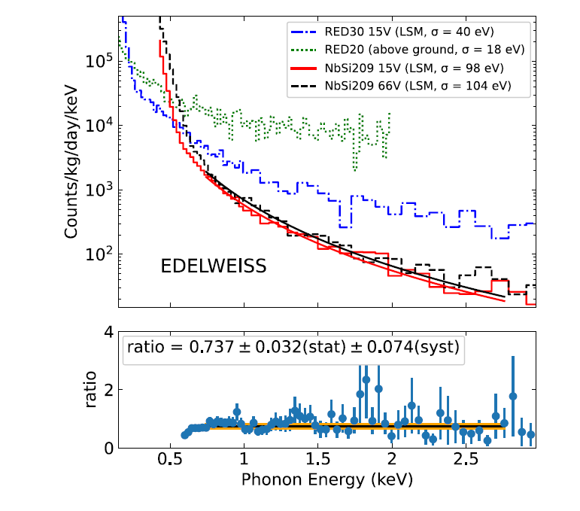
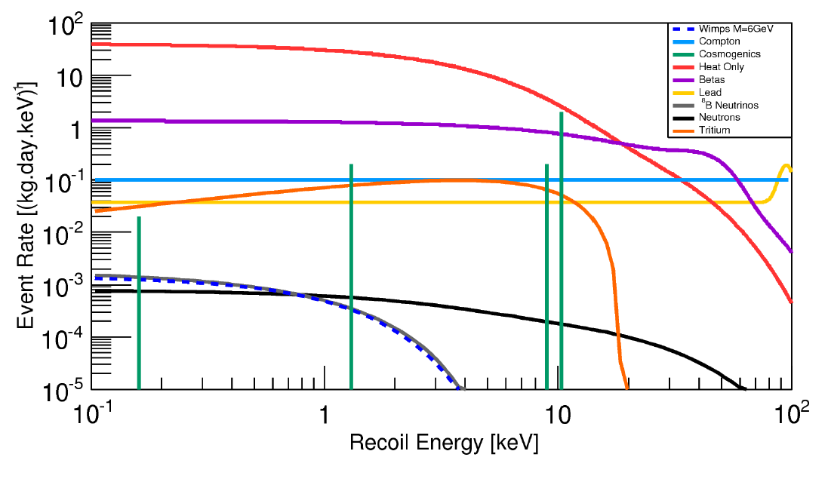
EDELWEISS sub-keV regime
• Sub-keV searches become background limited by “heat-only (HO)” events (no associated charge)
• Measured spectra at 15 V vs 66 V show no significant shape change
• Practical implication: in the ~100 eV–1 keV ROI, the limiting term is often instrumental/HO-like, not external particle flux
Heat spectra
<- particle background

Slide 21
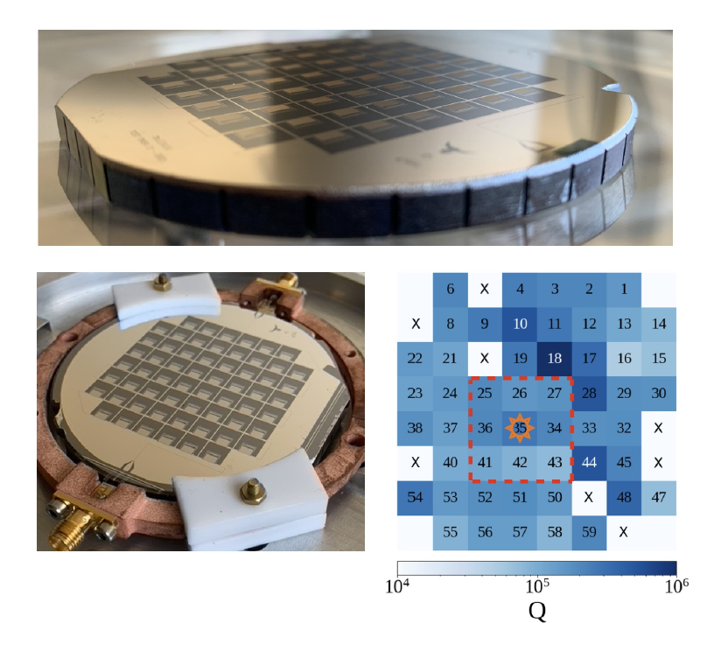
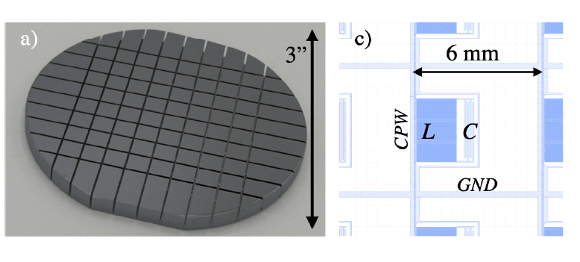
BULLKID detector concept and background-driven design
• Monolithic array of silicon absorbers (0.34 g per die) sensed by Kinetic Inductance Detectors (KIDs)
• Enable event-by-event veto using phonon sharing between dice
• Dice carved from a single crystal wafer, leaving a thin common disk for phonon propagation and KID lithography
• detector is placed inside a shielding pot with three layers (aluminum, copper, Cryophy), explicitly to protect the KIDs from thermal radiation and magnetic fields.

